Slide 1
Arcade 10c
Lamia Abbas, Gaurav Gulati, Cami Sowers

Slide 2
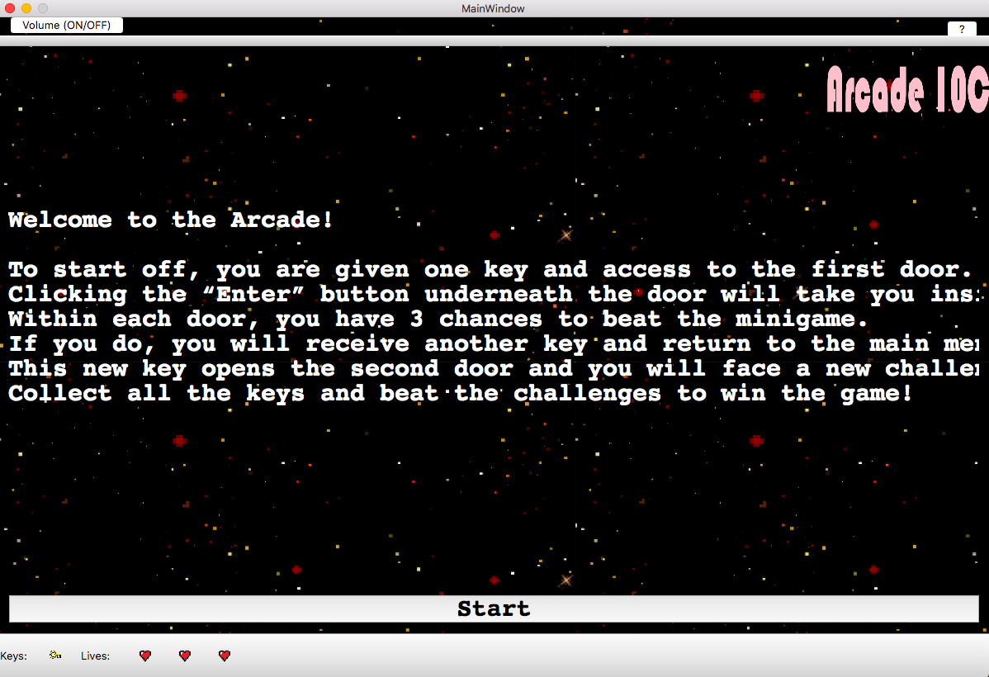
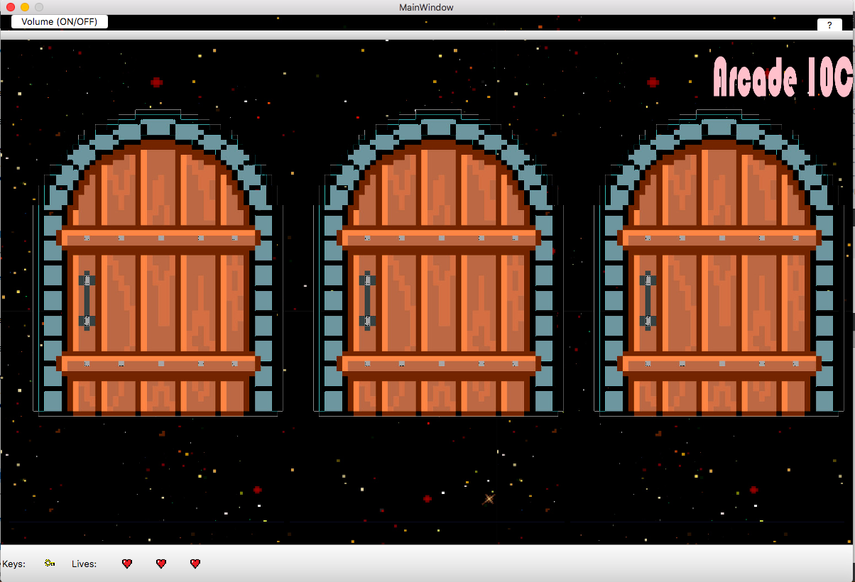
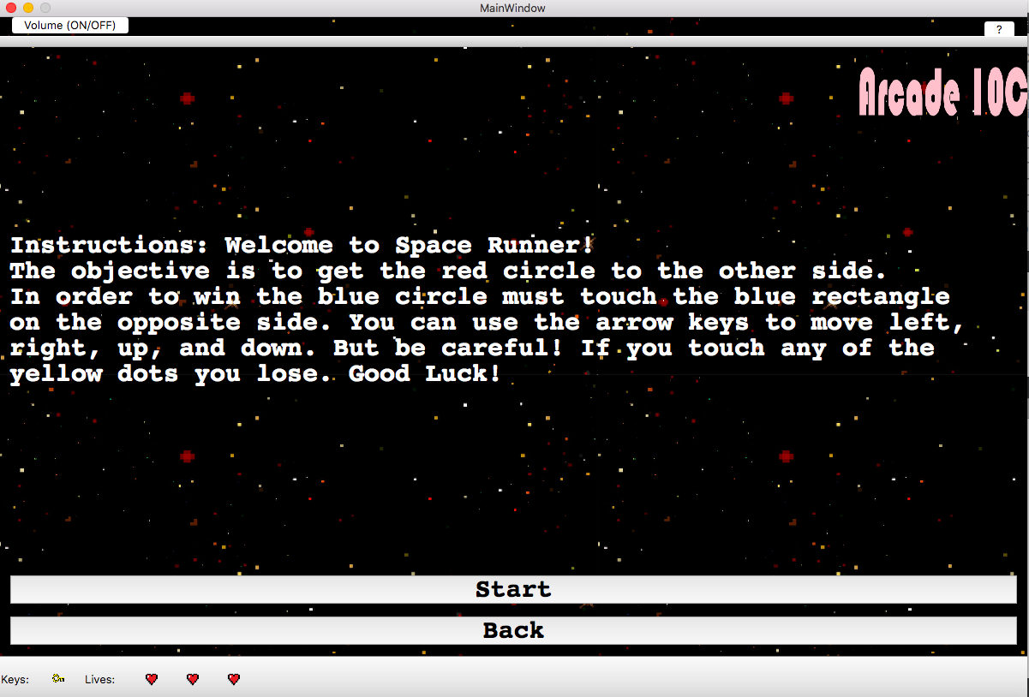
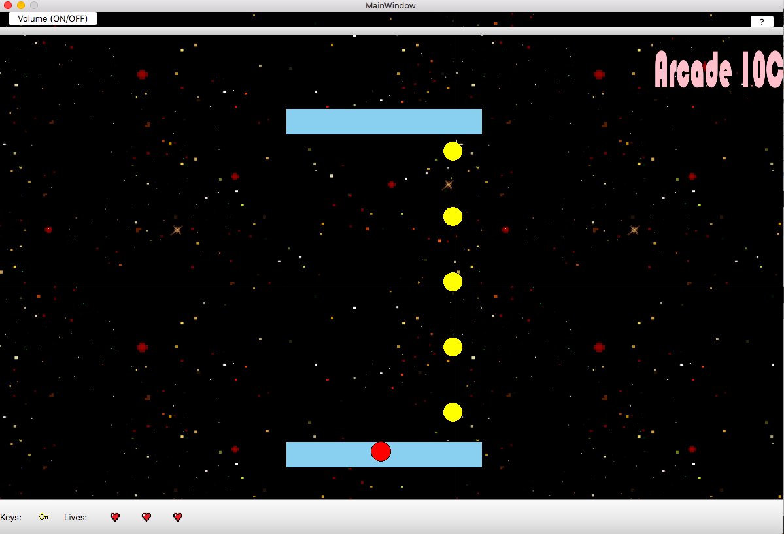
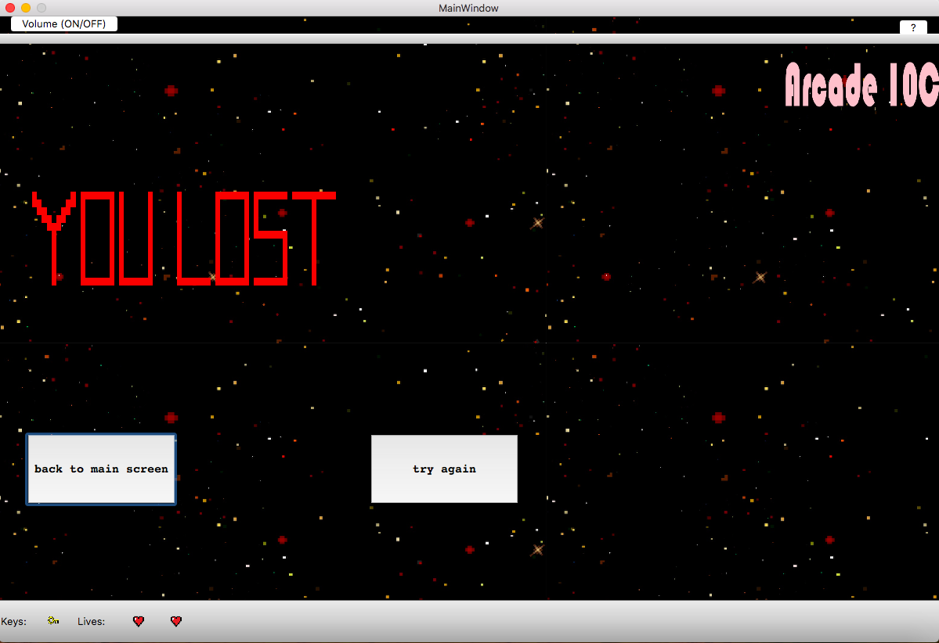
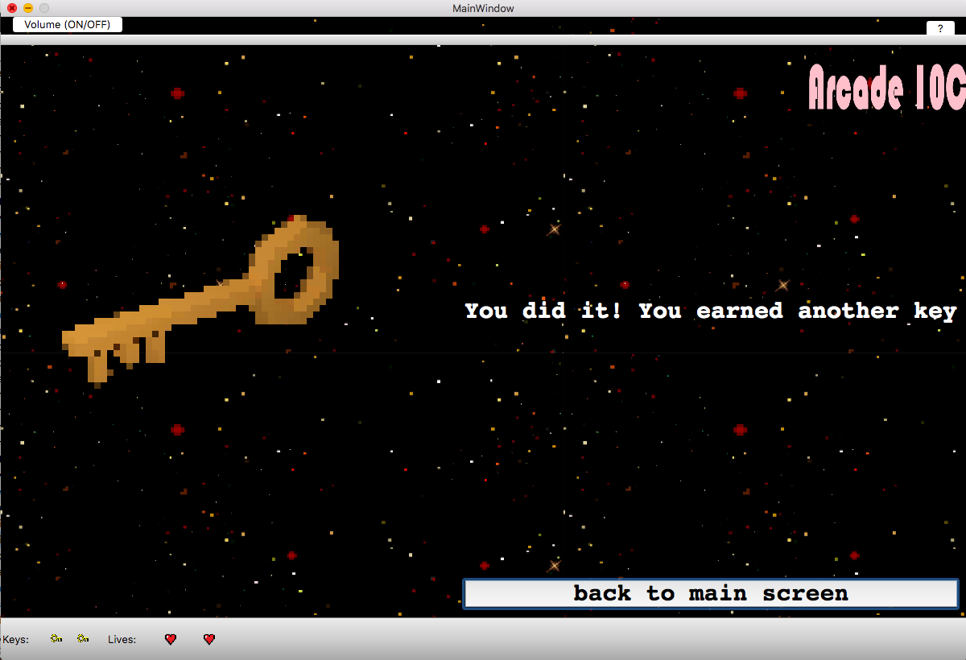
“Game over”view
Welcome Page
Door Page
Game One Instructions
Game One
Lose Screen
Win Screen

Slide 3
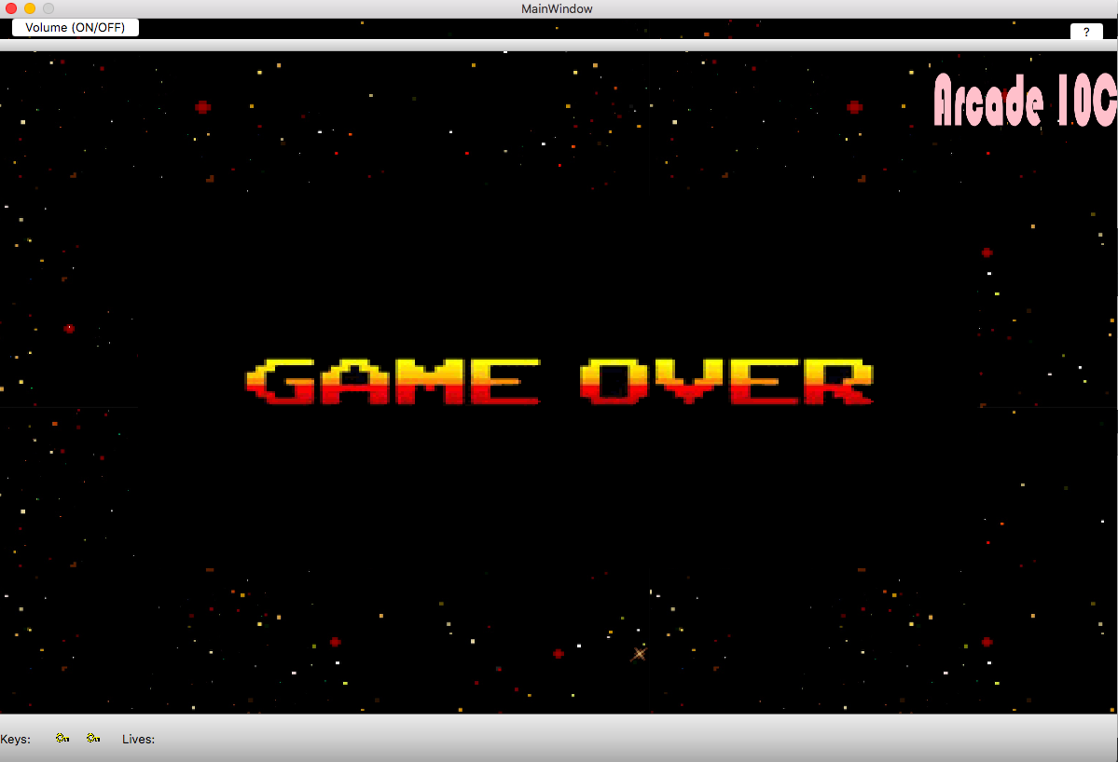
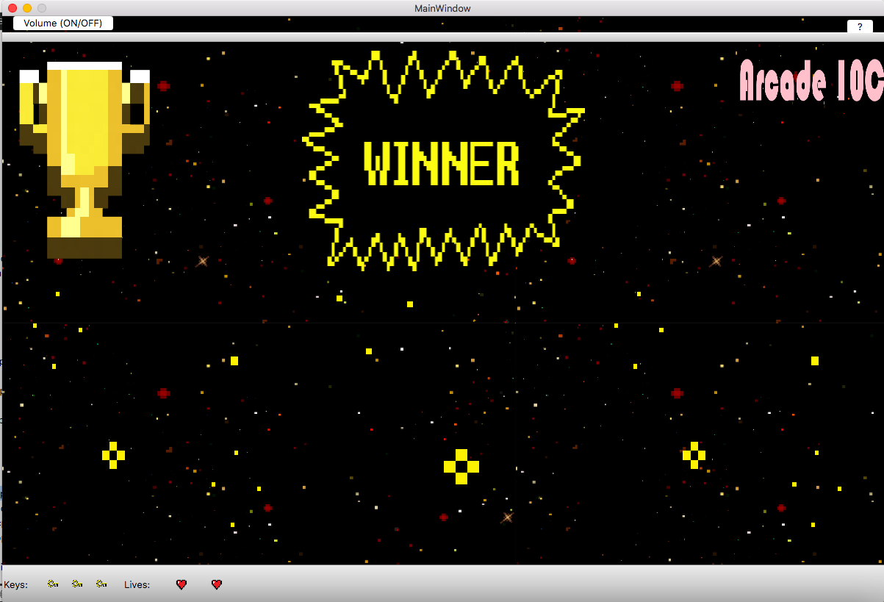
“Game over”view
Door Page
Lose Game
Win Game

Slide 4
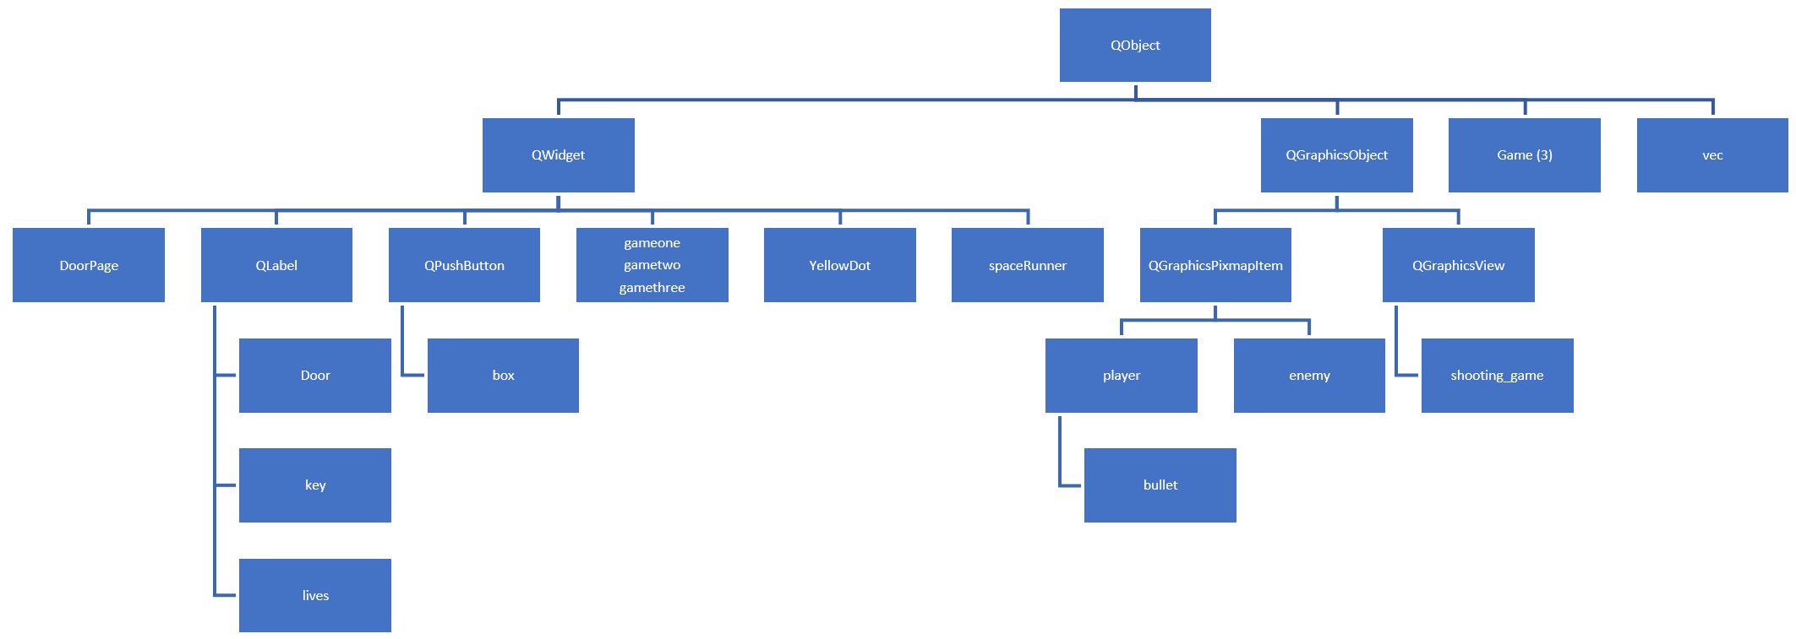
Class hierarchy

Slide 5
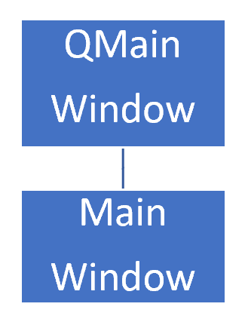
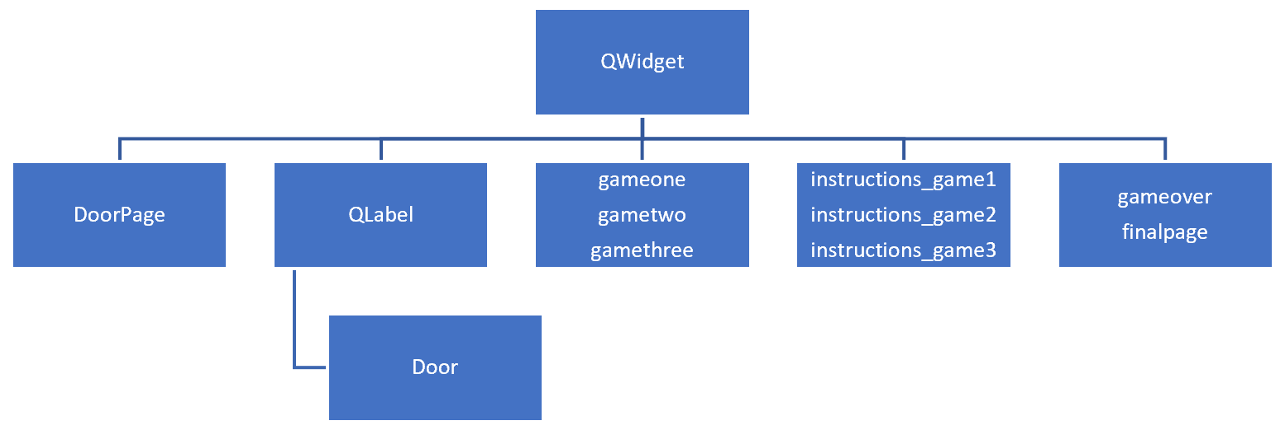
Class hierarchy (simplified)

Slide 6
Space runner
Derived from the World’s Hardest Game
Target: Get a red dot that can move left, right, up, and down
Have other yellow dots oscillating in the grid
Get your red dot that can move to the other side without hitting any of the yellow dots
Uses QPaintEvent

Slide 7
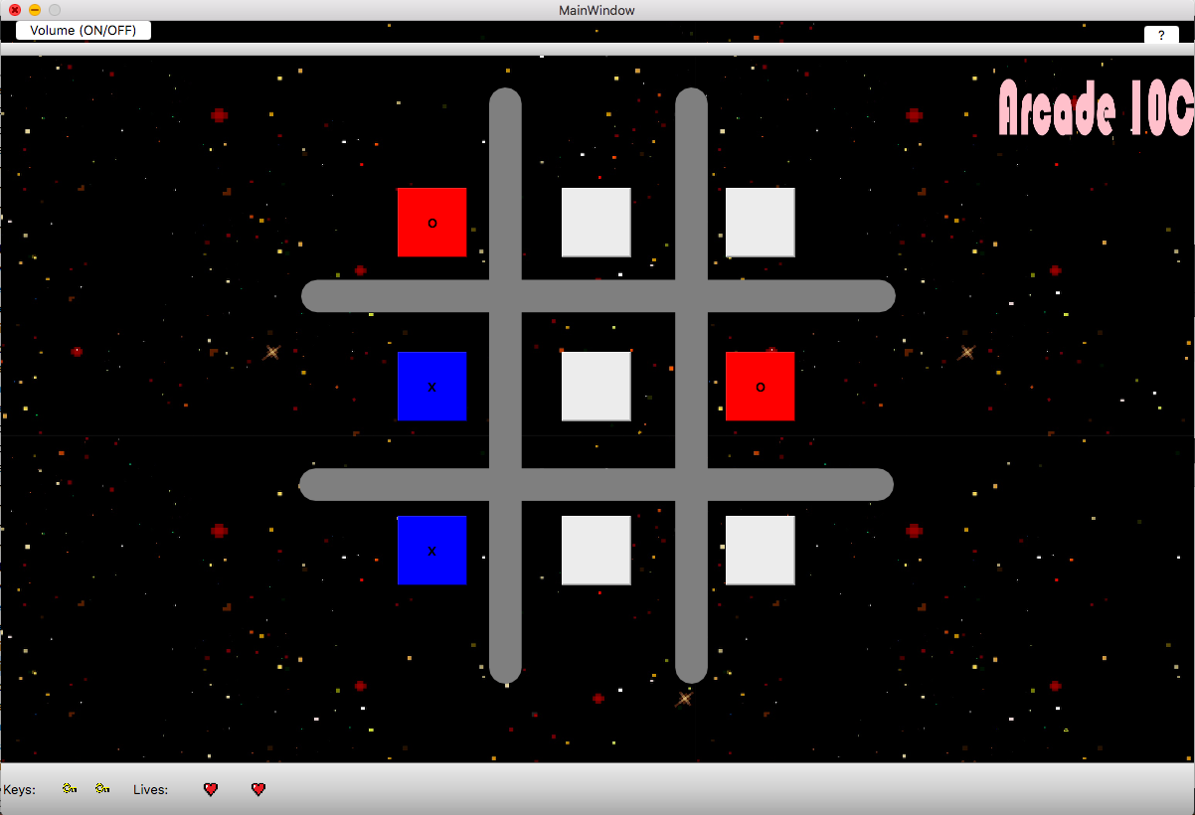
Tic Tac toe
Classic tic tac toe game
Grid with “box” objects inherited from QPushButton
Clicking box marks with X and changes color
Player goes first and computer will play in response
Checks if someone has won after every turn

Slide 8
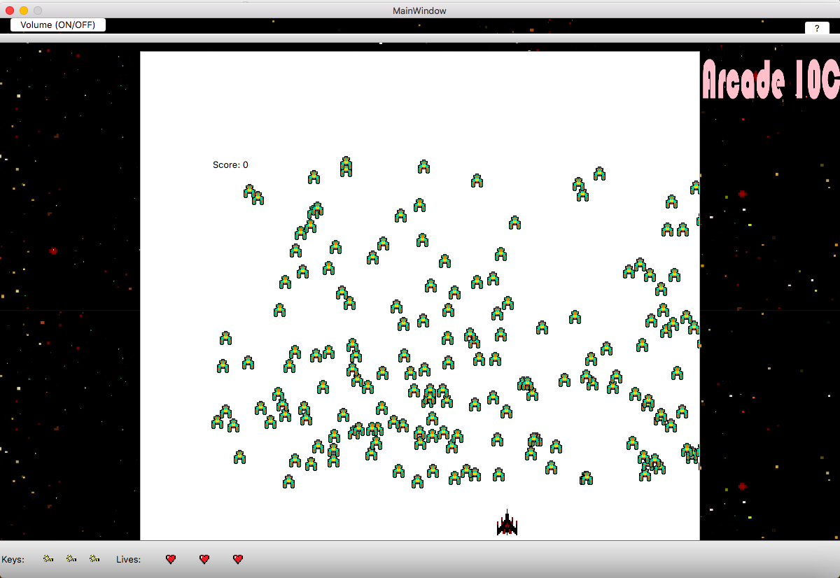
Alien invasion
Player is the spaceship
Enemy aliens fall by timer
Bullets created when user presses spacebar
Point for every enemy hit
Need 20 points to win
Die when enemy hits your spaceship
Uses QGraphicsScene

